Slide 1
Session 1
Module 1, 2: Basics of JDBC

Slide 2
Module 1,2 - Objectives
Introduction to JDBC
JDBC driver type
JDBC application development process
More on JDBC
Database meta information
Store procedures

Slide 3
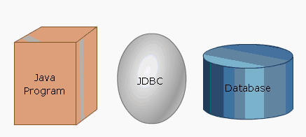
Introduction to JDBC
JDBC is a Java Database Connectivity API that is a part of the Java Enterprise API.
Defines a set of API objects and methods to interact with databases.
JDBC is a must for all Java applications that access data stored in external data providers like SQL Server, Oracle or Access.

Slide 4
Advantages of JDBC
Continued usage of existing data
Vendor independent
Platform independent
Ease of use

Slide 5
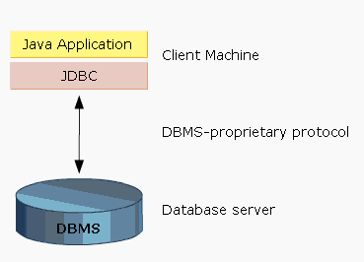
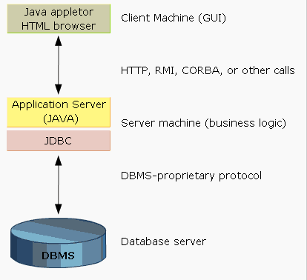
JDBC Architecture
Two-Tier Data Processing Model
Three-Tier Data Processing Model

Slide 6
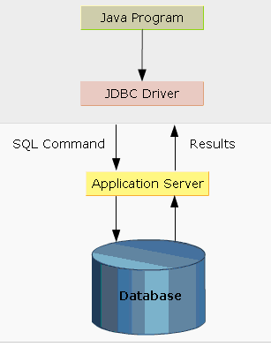
JDBC Architecture – JDBC API
JDBC API is a collection of specifications that defines the way how DB and the application communicate with each other.

Slide 7
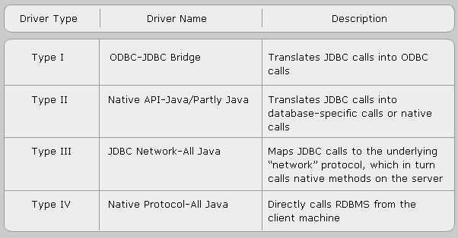
JDBC Driver Types

Slide 8
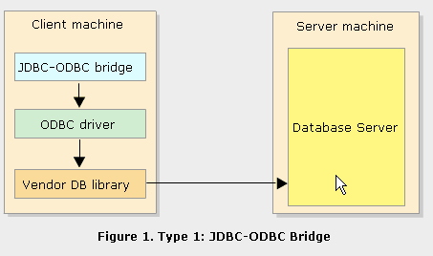
Driver Type 1:
JDBC-ODBC bridge plus ODBC driver

Slide 9
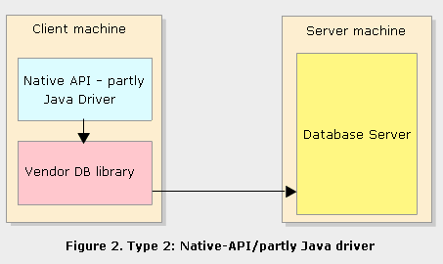
Driver Type 2:
Native-API partly Java driver

Slide 10
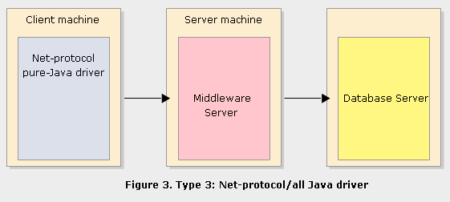
Driver Type 3:
JDBC-Net pure Java driver

Slide 11
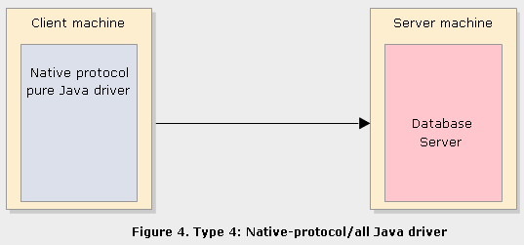
Driver Type 4:
Native-protocol pure Java driver

Slide 12

Steps to develop a JDBC Application (1)
Step 1: Register the JDBC driver
Using method: Class.forName(<protocol>);
  (protocol is the specification for the driver to be used)
Step 2: Establish DB Connection
Connection URL
  protocol:<subprotocol>:<subname>
DriverManager.getConnection()
  Connection cn = DriverManager.getConnection(<connection url>, <username>, <password>);
Step 3: Create and execute an SQL statement

Slide 13
Steps to develop a JDBC Application (2)
Step 4: Process the results
Using some methods of ResultSet to process queries:
getString();
getInt();
getFloat();
getObject();
Step 5: Close DB connection
  Using close method

Slide 14


More on JDBC (1)
Using “executeUpdate()” & “execute()” methodes
Handling Exceptions
  ClassNotFoundException
  SQLException

Slide 15

More on JDBC (2)
Creating parameterized query - pre-compiled query:
Passing parameters:
pStmt.setInt(1, 25);
pStmt.setString(2, “Production”);
Executing parameterized query:
pSmt.executeUpdate();

Slide 16
Database Meta Information (1)
Database metadata
  Metadata is data about data
  The structure and property of the data stored in a DB.
  In a table, metadata can includes:
    Column name
    Data types for columns

Slide 17
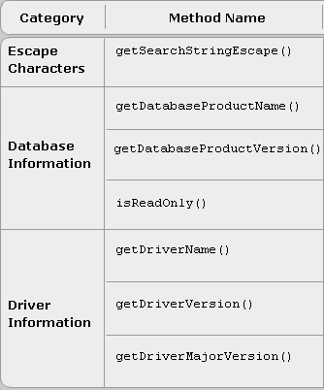
Database Meta Information (2)
Database MetaData
interface

Slide 18
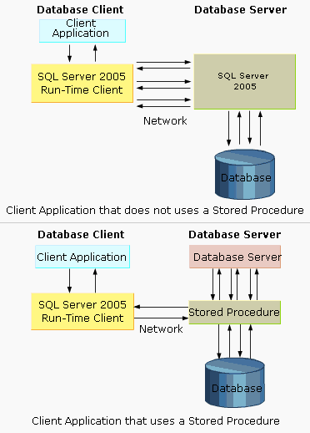
Store procedures
Contain SQL statements using constructors and control structures.
Can be invoked by name in an application that is using SQL.
Allow an application program to run in two parts such as the application on the client and the stored procedure on the server

Slide 19
Benefits of stored procedures
Reduced network traffic
Enhanced hardware and software capabilities
Increased security
Decrease in development cost
Centralized control

Slide 20
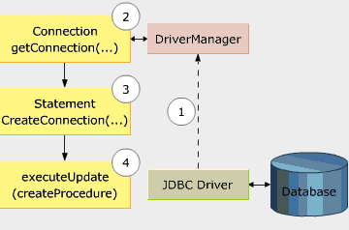

Creating a stored procedure

Slide 21
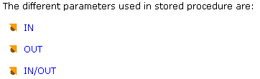
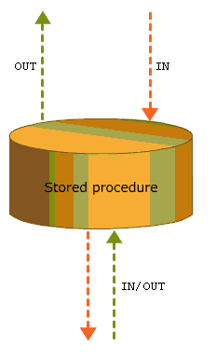
Parameters in Stored Procedures

Slide 22
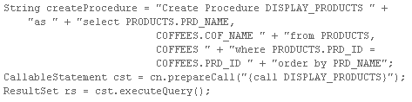
Using Callable Statement
Creating a “CallableStatement” object:
  CallableStatement cst =
  cn.prepareCall(“{call functionname(?, ?)}”);
Executing a S.P. using “Callable” statement:

Slide 23
Module 1, 2 - Summary
JDBC is a software API to access database connectivity for java applications
JDBC offers 4 different types of drivers to connect to the databases
java.sql package offers classes that sets up a connection with databases, sends the SQL queries to the databases and retrieving the computed results
The information that describes the data in database is known as the metadata

